Slide 1


SMART POLYPHARMACY AND VITAMIN RECOMMENDATION SYSTEM
Group ID : 25 – 26J - 368

Slide 2

Our Team
Group ID : 25 – 26J – 368
Supervisor - Ms. Jenny Krishara
Co-supervisor - Dr. Dinuka Wijendra
Student Name | Student ID
Reshmi M.G.G.K | IT22600448
Jeesara K.G.N | IT22561084
Jayalath J.P.R.J | IT22591098
Tharaka B.W.P | IT22600516

Slide 3
PROBLEM
Elderly patients often take multiple medicines at the same time (polypharmacy)
Increases risk of drug–drug interactions
Leads to incorrect or unsafe medicine combinations
Long-term medicine use causes hidden vitamin & nutrient deficiencies
Patients and caregivers lack tools to understand medicine effects
Doctor consultations are time-limited
Manual checking is slow and error-prone
Results in preventable health risks

Slide 4

Impact / Gravity of the Problem
High risk of adverse drug reactions
Increased hospital admissions
Causes fatigue, dizziness, falls, and weakness
Can lead to cognitive decline in elderly patients
Vitamin deficiencies often remain undetected
Worsens existing chronic conditions
Increases healthcare costs
Reduces quality of life
Adds pressure on caregivers & healthcare systems
Severe cases can become life-threatening

Slide 5

Who Is Affected / Who Benefits
Who is affected
👴 Geriatric patients
👨‍👩‍👧 Caregivers & family members
👩‍⚕️ Doctors & pharmacists
🏥 Hospitals & healthcare institutions
Who benefits from the solution
Patients get safer medication management
Caregivers gain clarity & confidence
Doctors receive decision support
Hospitals reduce medication-related risks

Slide 6
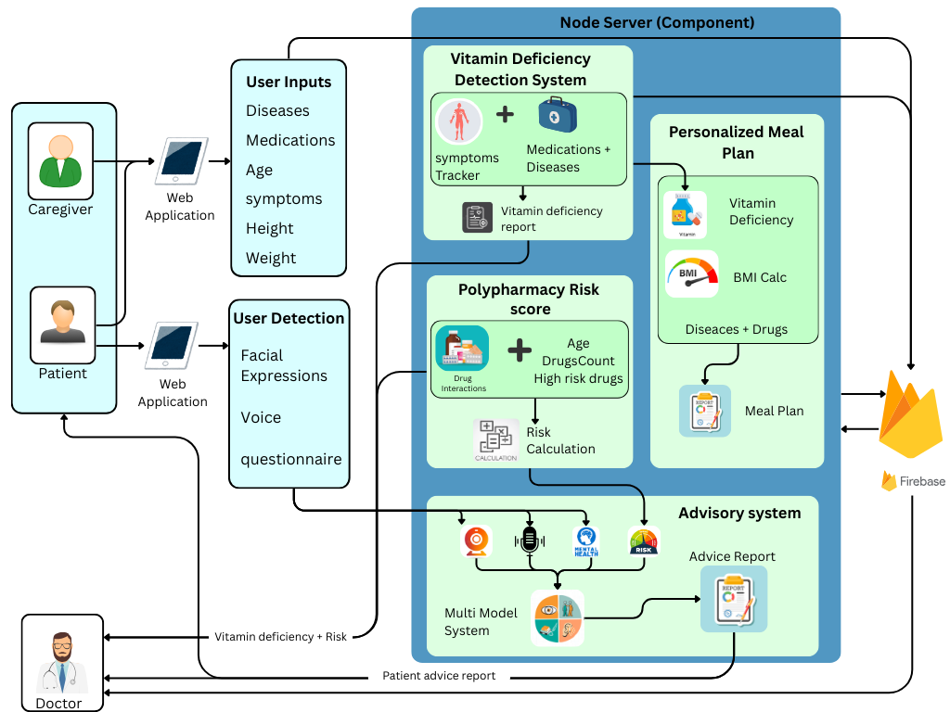
Overall solution as a system diagram

Slide 7

It22600448 | Reshmi m g g k
EARLY VITAMIN DEFICIENCY WARNING SYSTEM BASED ON SYMPTOMS AND LONG-TERM MEDICATION
Specialization : Information Technology
IT22600448 | Reshmi M.G.G.K | 25-26J-368

Slide 8

Sub-Problem Overview (What & Why)
Sub-Problem Identified
Geriatric patients often take multiple medicines long-term (polypharmacy)
Long-term medication use silently causes vitamin depletion
Symptoms appear gradually and are often:
Ignored
Misattributed to aging
Treated late
Why This Is a Real Issue
Doctors focus on disease treatment, not micronutrient loss
Patients rarely track:
Duration of medicine usage
Combined symptom patterns
Result → Undetected vitamin deficiencies → poor quality of life

Slide 9
How the Solution Addresses the Sub-Problem
What the Solution Does
Detects possible vitamin deficiencies using:
Reported symptoms
Long-term medication history
Works as an early warning system, not a diagnosis tool
How It Solves the Problem
Connects medicine–vitamin interaction knowledge with real patient data
Identifies hidden links between:
Medicine duration
Symptom clusters
Likely vitamin deficiencies
Gives patients and clinicians actionable insights early

Slide 10
Key User Requirements → Solution Mapping
User Need | How the System Addresses It
Easy symptom reporting | Emoji-based symptom selection
Track long-term medicine use | Duration input (months / years)
Avoid medical jargon | Clear vitamin names + effects
Early detection | AI-based prediction before severe deficiency
Non-invasive & safe | No lab tests required
Works with multiple medicines | Designed specifically for polypharmacy
Target Users
Geriatric patients
Caregivers
Clinicians (decision support)

Slide 11

Design Excellence & Contribution (WHAT)
Core Model Contribution
The problem was confirmed as multi-label classification
component introduces a hybrid prediction model that combines:
Symptom-based inference
Long-term medication impact analysis
Model Inputs
Selected symptoms (multi-label)
Medication names
Medication duration (time-aware feature)
Model Output
Predicted vitamin deficiency classes (e.g., B12, D, Folate, Iron)

Slide 12

Design Excellence & Contribution (HOW – Model Details)
Feature Engineering
Symptoms → encoded as multi-label vectors
Medicines → mapped to known vitamin depletion effects
Duration → weighted to increase deficiency risk over time
Model Architecture
Supervised ML classifier
Trained on:
Symptom–vitamin relationships
Medication-induced deficiency patterns
Handles imbalanced medical data
Decision Logic
Combines:
Symptom severity
Medicine duration impact
Produces probabilistic deficiency scores

Slide 13
Model | Feature Representation | Micro F1 | Weighted F1 | Notes
Logistic Regression (Baseline) | TF-IDF (1–2 grams) | 0.90 | 0.91 | Simple, interpretable baseline
Linear SVM | TF-IDF (1–2 grams) | 0.91 | 0.92 | Improved handling of sparse text
Final SVM (Cleaned + Semi-supervised) | TF-IDF (1–2 grams) | 0.94 | 0.95 | Best overall performance
Best model choices (ranked for the case):
Logistic Regression (TF-IDF) — baseline
2. SVM (TF-IDF) — better accuracy, great for small datasets
3. XGBoost (TF-IDF features)
4. DistilBERT / BioBERT (deep learning)

Slide 14
User Feedback on Prototype
Feedback Highlights
“Easy to understand even without medical knowledge”
“Helpful for elderly patients who forget lab follow-ups”
“Symptoms + medicine duration feels realistic”
“Clear output helps decide next steps”
Observed Benefits
Increased awareness of vitamin health
Better patient–doctor communication
Reduced guesswork in early stages

Slide 15

It22561084 | JEESARA k g n
PERSONALIZED MEAL PLAN RECOMMENDATION SYSTEM FOR VITAMIN DEFICIENCY
Specialization : Information Technology
IT22561084 | Jeesara K G N | 25-26J-368

Slide 16

Component Overview
This component is responsible for generating personalized meal plans for geriatric patients.
It uses patient information such as BMI, age, medical conditions, and vitamin deficiencies.
The component analyzes health data to recommend suitable meals and daily calorie intake.
It produces a structured weekly/Monthly meal plan that supports healthier dietary habits.
This module acts as a core decision-making component within the overall system

Slide 17
How the solution addresses the sub-problem / prototype
This component focuses on generating a personalized meal plan based on patient health data.
It analyzes BMI, medical conditions, and vitamin deficiencies to recommend suitable meals.
A prototype was developed to automatically generate weekly meal plans using backend logic.
User requirements addressed by the solution
Users need a personalized meal plan instead of a general diet.
The system provides health-based meal suggestions suitable for polypharmacy conditions.
Users can view daily calorie intake and meal details clearly.
Design excellence / contribution
Implemented a modular backend design separating logic and data handling.
Used optimization logic to balance calories, nutrients, and restrictions.
Designed an easy-to-understand output format for better user experience.

Slide 18
User feedback on the prototype
Users found the meal plan recommendations helpful and easy to understand.
The weekly plan view was appreciated for clarity and structure.
Patients liked seeing calorie values and meal breakdowns.
Improvements based on feedback
Added an option to save selected meal plans.
Improved meal variety by increasing food dataset size.
Enhanced UI design for better readability and interaction.
Current status
Prototype successfully generates personalized meal plans.
Component is integrated with the main system and backend database.
Ready for further testing and evaluation.

Slide 19

IT22591098 | JAYALATH J P R J
POLYPHARMACY RISK SCORE
SYSTEM BASED ON DRUG
INTERACTION
Specialization : Information Technology
IT22591098 | Jayalath J.P.R.J | 25-26J-368

Slide 20
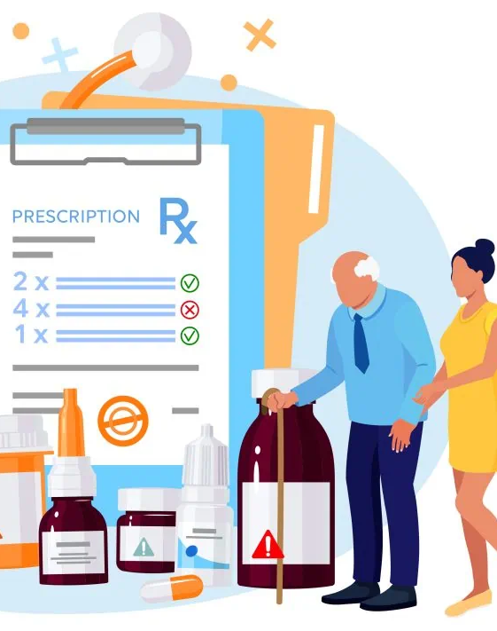
Component Overview
Analyzes polypharmacy risk in elderly patients by evaluating multiple concurrent medications at a time .
Identifies and classifies drug–drug interactions based on clinical severity and impact.
Computes a dynamic, patient-specific polypharmacy risk score system using
Age > 65
drug count > 5
Drug interaction Severity Level (Major,Moderate,Minor)
kidney function and liver function stages.
Supports safer and more informed clinical decision-making to reduce adverse drug events and improve patient safety.

Slide 21
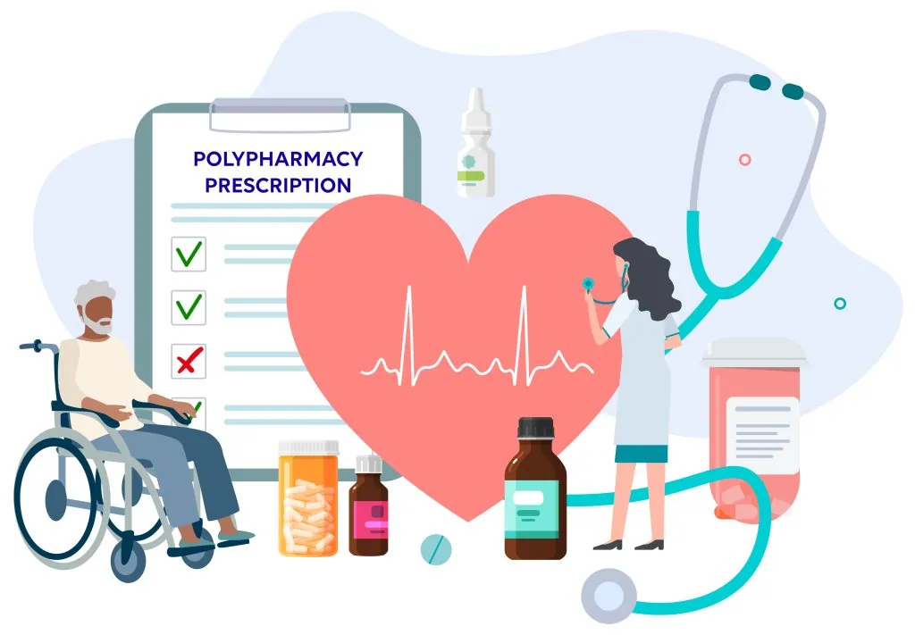
How the solution addresses the sub-problem / prototype
Calculate risk using expert knowledge for Analyzes polypharmacy risk in elderly patients.
Detects drug–drug interactions with severity levels (Major, Moderate, Minor).
Calculates a dynamic risk score using age, drug count, liver and kidney function.
Provides more accurate and personalized results compared to traditional static systems.
User requirements addressed by the solution
Easy input of multiple drugs with auto-suggestions .
Clear and understandable risk levels (Low, Moderate, High, Very High).
Fast, real-time analysis for clinical decision support.

Slide 22

Design excellence / contribution
Hybrid model combining evidence-based scoring with interaction severity.
Modular backend design with a dedicated scoring engine.
Strong input validation (drug limits, duplicate removal).Transparent scoring with clear S1–S5 breakdown.
User feedback on the prototype
User Feedback on PrototypeRisk score visualization is clear and informative.
Interaction severity details support safer prescribing decisions.Overall prototype evaluated as practical and clinically useful.
Future Enhancement
Predict the next Adverse Drug Event considering the patient using current age, Drugs and current diseases

Slide 23

It22600516 | Tharaka B W P
PERSONALIZED MENTAL HEALTH
AND LIFESTYLE ADVISORY SYSTEM
FOR GERIATRIC PATIENTS
Specialization : Information Technology
IT22600516 | Tharaka B.W.P | 25-26J-368

Slide 24
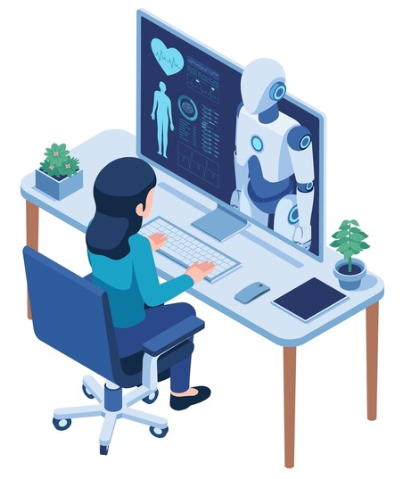
Component Overview
Sub-Problem Identified
Geriatric patients managing multiple long-term medications (polypharmacy) often experience mental and emotional challenges. These issues are commonly:
Mental health changes develop gradually and are often:
Stress, anxiety, low mood, and loneliness
Changes in daily lifestyle and routines
Emotional discomfort linked to long-term medication use
Overlooked
Misattributed to aging
Managed through additional medications
Why This Is a Real Issue
Medical care primarily focuses on physical conditions and prescriptions, not emotional and lifestyle well-being. Elderly patients rarely receive:
Continuous mental health monitoring
Lifestyle-based, drug-free support
Personalized guidance aligned with polypharmacy risk
IT22600516 | Tharaka B.W.P | 25-26J-368

Slide 25
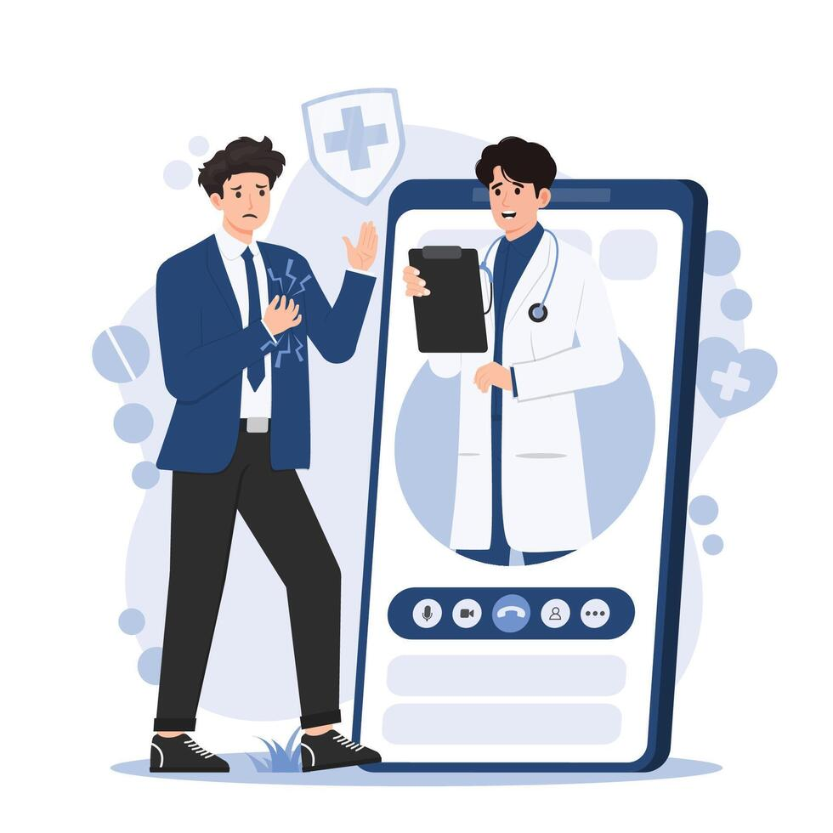
How the Solution Addresses the Sub-Problem
Monitors Mental and Emotional Well-Being Uses facial expression analysis and interaction tracking to detect stress, low mood, and emotional changes in elderly patients.
Integrates Polypharmacy Risk Awareness Considers the user’s polypharmacy risk score to provide lifestyle guidance that is safe alongside prescribed medications.
Provides Drug-Free Personalized Recommendations Suggests improvements in daily routines, physical activity, sleep, and stress management without interfering with medical treatment.
Supports Preventive Lifestyle Management Encourages healthy habits, self-awareness, and routine tracking to reduce long-term lifestyle-related risks.

Slide 26

Key User Requirements → Solution Mapping
User Need | How the System Addresses It
Monitor emotional well-being | Facial expression and mood analysis for real-time mental health feedback
Personalized guidance | Drug-free lifestyle and wellness recommendations
Easy to use for elderly | Large text, simple navigation, and emoji-based or visual inputs
Safe alongside medications | Integrates polypharmacy risk score to ensure advice does not conflict with medical care
Non-invasive & stress-free | No medical tests; fully digital and supportive
Target Users
Geriatric patients
Caregivers
IT22600516 | Tharaka B.W.P | 25-26J-368

Slide 27
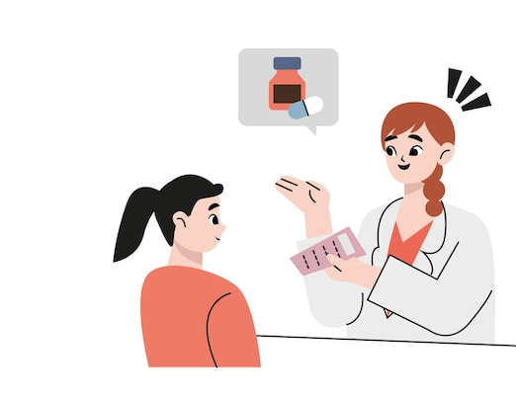
Design Excellence & Contribution (WHAT)
Core System Contribution
The system addresses non-medical lifestyle and mental wellness for geriatric patients, focusing on support alongside polypharmacy. The prototype introduces a hybrid advisory model that combines:
Facial expression & mood analysis for mental wellness assessment
Lifestyle habit analysis (sleep, physical activity, past occupation)
Polypharmacy risk awareness to ensure safe, personalized guidance
System Inputs
User emotional state (via facial expressions)
Daily lifestyle data
Polypharmacy risk score (derived from medication list and duration)
System Output
Personalized lifestyle and mental wellness advice
Daily reminders and routine recommendations
IT22600516 | Tharaka B.W.P | 25-26J-368

Slide 28
User Feedback on Prototype
1. Ease of Use
Users found the interface simple and intuitive.
Some elderly users suggested larger buttons and clearer fonts for better readability.
2. Personalized Advice
Users appreciated receiving lifestyle tips tailored to their medication profile and emotional state.
A few requested more detailed explanations for why certain advice is given.
3. Mental Health Monitoring
Positive feedback on daily mood tracking and facial expression recognition.
Some users suggested optional reminders or notifications to ensure consistent use.
4. Overall Experience
Users felt more aware of their emotional well-being and lifestyle habits.
They reported a sense of support without relying on extra medications.
Suggestions included gamification elements or small achievements to encourage engagement.
IT22600516 | Tharaka B.W.P | 25-26J-368

Slide 29
PROJECT OVERVIEW & COMMERCIALIZATIONES WORKFLOW
Target Market & Customer Profile
Ability of Commercialization
Investment / Cost & Recovery:
:
Elderly individuals on long-term medications (primary users).
Caregivers and family members seeking proactive health monitoring.
Offered as web app for hospitals, clinics, and users.
Subscription/licensing model for healthcare providers.
Integrates with existing health systems for wider adoption.
Cloud servers
app infrastructure
Recovery Strategy:
Subscription plans for clinics and hospitals.
Premium model for individual users with optional premium features.
Partnerships with health insurers or wellness programs.
Value Proposition:
Early detection of vitamin deficiencies, improving patient health outcomes.
Personalized dietary & supplementation recommendations.
Reduces hospital visits and lab testing costs.
Intellectual Property Rights
:
Proprietary AI algorithms for predictive deficiency detection.
Database schema, recommendation engine, and app design protected under copyright.
Potential for patenting predictive model and unique multi-factor integration method.

Slide 30


